Slide 1

Glance 2.0
ICG | Rates
Summer Analyst Presentation | 7/22/18
Summer Analyst – Rates
Mandy Hsu, Vincent Taylor, Tahiya Chowdhury
July 23rd, 2018
Strictly Private and Confidential

Slide 2
Agenda
About Us
Our Assignment
Snapshots
Our Technology
Challenges/Solutions
Impact
Q/A

Slide 3
1. About Us

Slide 4
Rates – ICG Technology
Our Team
Mentors/Buddies
Sam Eberspacher
Vincent Taylor
Moshe Teitz
Mandy Hsu
Tenzing Passang
Tahiya Chowdhury
Rates Technology
Managers
Phillip Jung
Jonathan Elphick

Slide 5
G10 Rates Technology
G10 Rates
Mission: Generate revenue off client flow while prioritizing efficiency and safety
Products: securities like bonds, exchange traded derivatives (such as Eurodollar Futures), and over-the-counter(OTC) interest rate derivatives like swaps
E-trading – trading securities electronically
Trader Desktop: For pricing, risk and data analysis
IMM (Internal Market Making): Algo, Velocity trader tools, legger and etc
Distribution: Price streaming, RFQ, and Market connectivity
Pricing: Graphite for curves and pricing, swap curves
Notes:
G10 rates include G10 trading, G10 sales, Quants, MRM (market risk management) , PCG, Audit and other legal support team, and production support.
G10 rates tech itself has several departments: e-Trading, TPS (official trade capture service), MTFD (markets treasury finance desk), risk

Slide 6
2. Common Slides
2. Our Assignment

Slide 7
Rates – ICG Technology
Glance
How it worked
Primary Functions
Monitoring existing tools’ health status that are internal to rates
Participating Members
Glance
Tasks
MKV Fetch
Tasks
Web Server
Tasks
Glance 2.0
Our Changes
Primary Functions
Monitoring existing tools’ health status that are internal to rates
Participating Members
Glance 2.0
Ignite Cluster
Tasks
Web Server
Tasks
Notes:
Suggestive script: The competitive advantage that supports the bulk of the team’s fundamentals is stability, agility and experience. These three goals inspired our summer project, which is to take an existing functioning program, Glance, and upgrade it with a new backend for scalability and a new frontend for a better user experience.
So what is Glance? It is an internal system that monitors the health status of existing tools such as the bond pricer. Basically based pre-written check scripts, written in groovy or python, Glance would notify the production support team of specific issues with each failing tools.

Slide 8
3. Snapshots

Slide 9
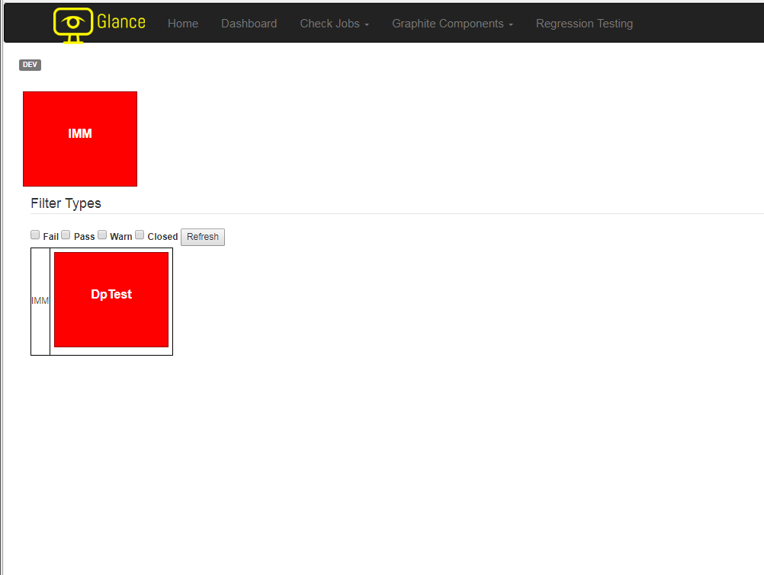
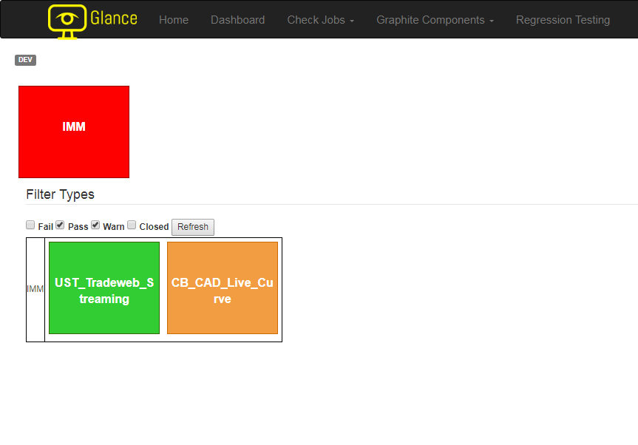
Glance Snapshots
Home page of Glance 2.0: Filters the nodes by their status and displaying those failing by default for immediate attention
3
Text and Layouts
Notes:
To show a simple demonstration of how the UI works, we start with the home page. By default, the home page would display the main categories that all tools fall under. For our particular group, the platform usually carries Pricing, IMM, and Distribution. The table below would display all failing tools, if any, within their respective category.

Slide 10
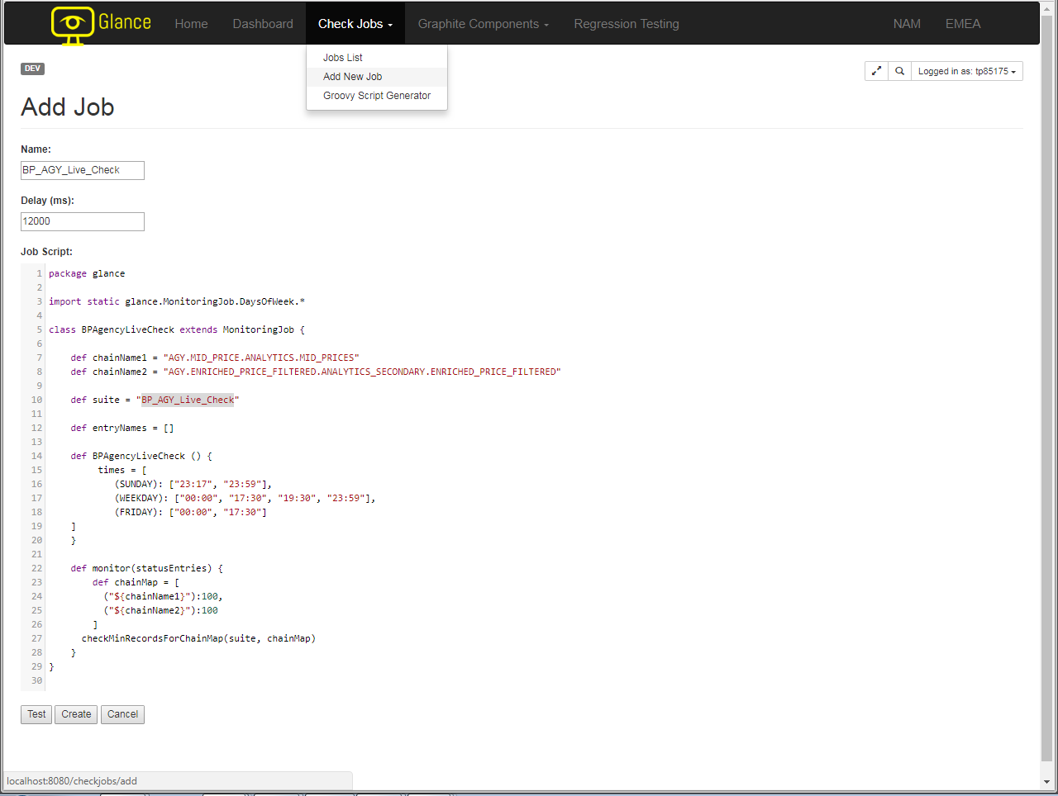
Glance Snapshots
3
Text and Layouts

Slide 11
Glance Snapshots
3
Text and Layouts

Slide 12
Ignite Snapshots
3
Text and Layouts

Slide 13
4. Our Technology

Slide 14









Technology Stack
4

Slide 15
Compositional and Organizational Principles
Using the following basic rules and tips when assembling a presentation helps us communicate clearly and effectively.
Presentation Do’s
Understand objectives
Communicate message in a clear and concise manner
Showcase Citi capabilities
Demonstrate business and industry knowledge
Use case studies to illustrate Citi credentials and qualifications
Establish key themes up front and provide support in Body or Appendix
Convey themes graphically whenever possible
Abide by the style guide to ensure a consistent work product
Target 20-page books
Presentation Do Not’s
Present exhaustive financial analysis with no clear message
Repeat pages at different sections of a presentation
Develop independent styles
Use qualification pages (e.g. tombstones, statistics, league tables) excessively
5
Text and Layouts

Slide 16
5. Challenges/Solutions

Slide 17
Challenges and Solutions
Software installation: CMP requests delay project work
Solution: Constant communication with mentors and help desks to expedite the process
Maintaining development standards while adding new features
Solution: working with the experts in the team and regular scrums amongst ourselves
New software, tools, programming languages
Solution: mentorship from team, external documentations

Slide 18
6. Impact

Slide 19
Impact
Usability
Incorporation of SQL syntax for simplicity
Immediate reach to critical data
Performance
Ignite increased our backend capacity
Rearrangement of the user interface to minimize response time

Slide 20
Questions?

Slide 21
References/Sources
https://ignite.apache.org/

